Slide 1
Microbiota and Cardiometabolic Disease
Bert Groen
AMC-VUmc Diabetes Center
Amsterdam
Notes:
30 min talk + 15 min questions

Slide 2
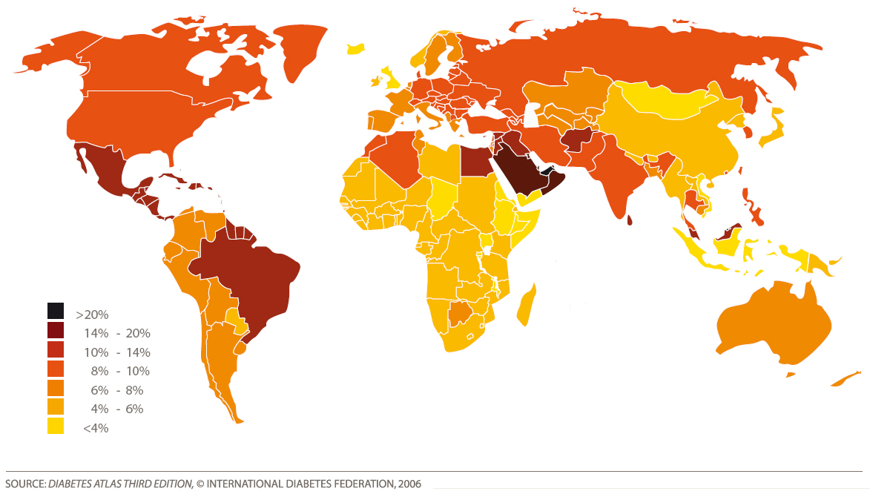
Estimated Diabetes prevalence in 2025
In 2050 15-20% adults worldwide will develop DM2 during their life
Notes:
Old slide, but differences in prevalence are clear, look at the middel east. How is sweden

Slide 3
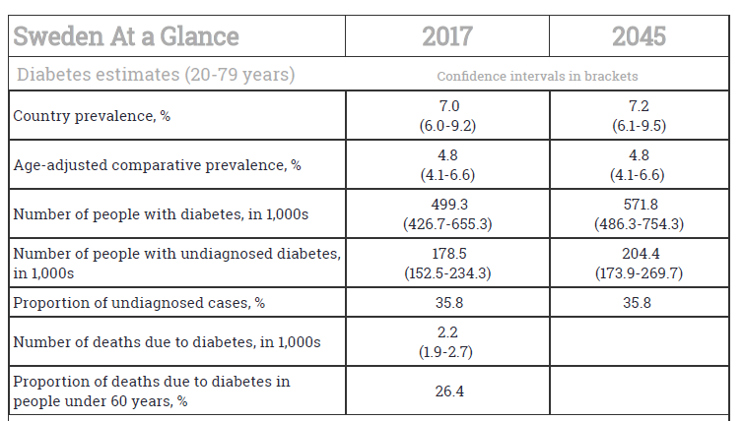
Notes:
7% in 2017 is a lot, curiously the IDF is optimistic no change in 2045; 7% is 0,5 mil; look at th detah toll 2200, much higher than traffic accidents

Slide 4

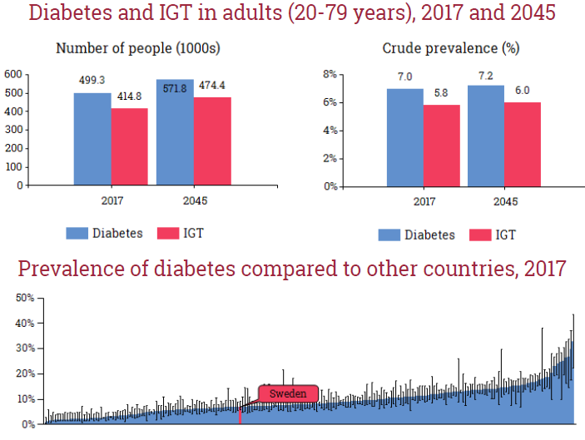
Notes:
Sweden located at the lower end, US around 9 and there proabbly the middle east. Causes of differences in location Ethicity or factors in environment or diet

Slide 5
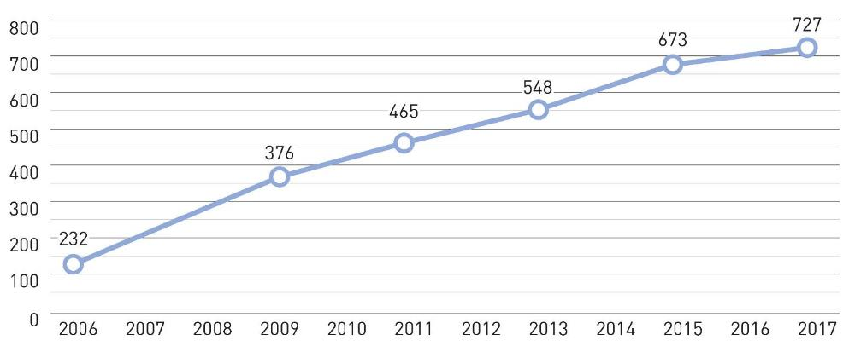
Total healthcare expenditure by people with diabetes (20-79 years)
*Billion USD
Notes:
Enormous costs

Slide 6
Estimated Diabetes prevalence in 2025
In 2050 15-20% adults worldwide will develop DM2 during their life
Notes:
Old slide, but differences in prevalence are clear, look at the middel east. How is sweden

Slide 7

Multiethnic HELIUS cohort (Healthy Life in an Urban Setting) in Amsterdam, the Netherlands
22,165 participants (18-70 years) included between 2011 and 2016
6 ethnic groups in similar proportions: Dutch, Surinamese (African and South-Asian descent), Turkish, Moroccan and Ghanaian
Preferably 3 generations from one family (grandparents-children-grantchildren) included
Otherwise healthy (at baseline visit 30-50% obese with signs of metabolic syndrome)
Data collected:
Questionnaire: sociodemographics, ethnicity, lifestyle, dietary habits, health, physical activity
Physical examination: anthropometric measurements, clinical measurements, blood draw, medications, DNA, urine samples, vaginal and oral swabs for microbiome analyses
Morning feces samples > 6000 subjects
Detailed Food Frequency Questionnaires
*
*
*
*
*
*
*
Currently sequenced (16S) 2048 fecal samples in collaboration Fredrik Backhed (Gothenburg
(Dekker, BMC Public Health 2011; Stronks, BMC Public Health. 2013)
Notes:
In NL the etnicity factor is investigated in the Helius cohort; see text

Slide 8
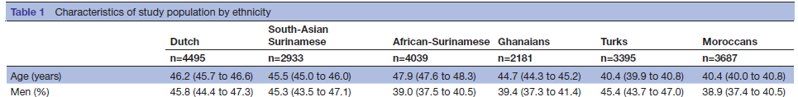
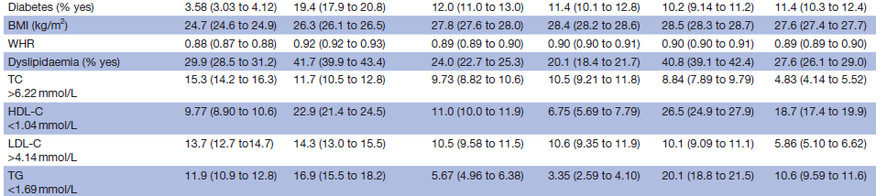
Considerable difference in incidence diabetes in multiethnic HELIUS cohort
Notes:
Tremendous diffrence in diabetes incidence; not much difference in BMI3.6 to 19.4; CVD incidence shows the same pattern but no difference in LDL; question

Slide 9
Unanswered questions and unsolved problems intestinal microbiota and human glucose metabolism in the clinic
What is driving increased glucose levels and diabetes in humans of different ethnicity?
Are (small) intestinal microbiota involved in insulin resistance and metabolism; causal factor or disease modifier?
Gutmicrobiota and metabolic syndrome; from group to individual (responders-non responders)?
How do microbiota exert their systemic effect on metabolism (gut-brain axis important in humans?)
Can single bacterial strains (like FMT) have beneficial effects on metabolic disease in certain subgroups?

Slide 10
Gutmicrobiota composition in other ethnicities besides Caucasians in relation to diet and obesity?
Holmes E, Cell Metabolism 2012 16, 559-564

Slide 11
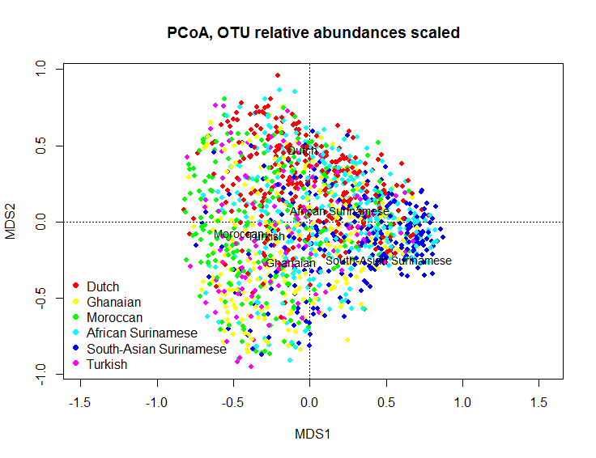
Gutmicrobiota diversity across different Ethnicities in all currently sequenced (n=2048) HELIUS subjects
Melanie Deschasaux Andrei Prodan Evgeni levin
Diversity in different ethnicities
Even after correction for dietary intake
No gender effect
Deschaschaux et al, Nature Medicine 2018
Notes:
Satisticians and bioinformaticians. Yes, diversity was different and correlated with diabetes incidence southasian surinamese highest, dutch lowest; Difference still present after correction for diet; actually bad diet consumption higher in the dutch Cause or effect

Slide 12
Causality is not the same as causation

Slide 13
Acknowledge the pink elephant in the room of current microbiota research
Caveats
1. New confounders of gutmicrobiota compositin like ethnicity; does gene-environment interaction drive differential gutmicrobiota dietary processing?
2. Large Sample size (~1700 subjects) is probably needed to adequately asses the relationship between obesity and microbiota composition in a cohort study when one corrects for age, gender and other variables eg. (medication and diet)
3. Different outcomes of bioinformatic pipelines (QIIME vs Mothur)
4. Are gutmicrobiota and their derived metabolites causally involved in human obesity and its sequelae?
5. If so, can we use these metabolites and microbial strains to restore this intestinal microbial balance and metabolism?
Notes:
Pink elephant = hallucination
Elephant in the room = problem nobody wants to acknowlegde

Slide 14
2. Causality of intestinal microbiota composition in human (glucose) metabolism and obesity?
Holmes E, Cell Metabolism 2012 16, 559-564
Notes:
Many possible interactions, apart from otu; functionality, how to cheack causation

Slide 15
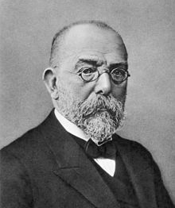
Koch’s postulates for causality of bacteria in human metabolic disease
The microorganism must be identified/isolated from a diseased organ(ism).✔
The microorganism should be associated with disease (association/intervention) in people. ✔
The introduced microorganism should reproduce fenotype (inoculation). X

Slide 16
Fecal transplant - History
2. Fecal transplant
Past
4th Century BC: Chinese medicine, food poisoning and diarrhea^{1,3}
^{16th} Century AD: Li Shizhen “yellow soup”, gastro-intestinal illness^{2,3}
1958: Eiseman, antibiotics-induced chronic diarrhea
Present
Ge Hong (Dongjin Dynasty) (2000) Zhou Hou Bei Ji Fang. Tianjijn Science & Technology Press: Tianjin, 2. Li S (Ming Dynasty) (2011) Ben Cao Gang Mu. Huaxia Press: Beijing.
3. Faming Zhang et al, , American College of Gastroenterology 2012: 1755
Notes:
Ge Hing, a traditional Chinese medicine doctor, used human fecal suspension given orally to treat food poising and severe diarrhea^{1.}
Li shizhen: very notable chinese doctor/scientist/among other things. Used fermented, fresh, dried of infant feces ( “yellow soup”) for the treatment of several gastro-intestinal related illness, including constipation².
Fecal transplant was first performed in current medical practice by Eiseman (Surgery 1958) 4 patients with antibiotics induced chronic diarrhea

Slide 17
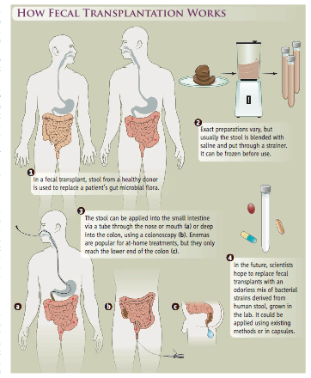
Screening donors (non medical 18-50y) (IRB,blooddonation protocol):
Questionnaire (bowel habits, travel history, medication, relatives) , no crossing sexes
Screening pathogens (C.diff, ESBL, VRE), FOBT
Bloodborn viruses (HepatitisA/B/C/E, HIV, HTLV, CMV, EBV)
Parasites (DFT PCR)
Diet (vegan/carnivore)
1:10 donors eligible ($7000), valid for 6 months
Fresh donation (no glycerol)
EU
USA
De Vrieze, Science 2013
Notes:
donors

Slide 18
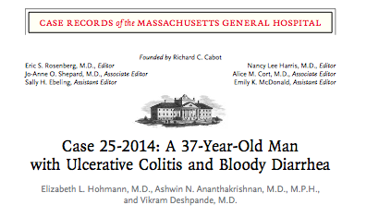
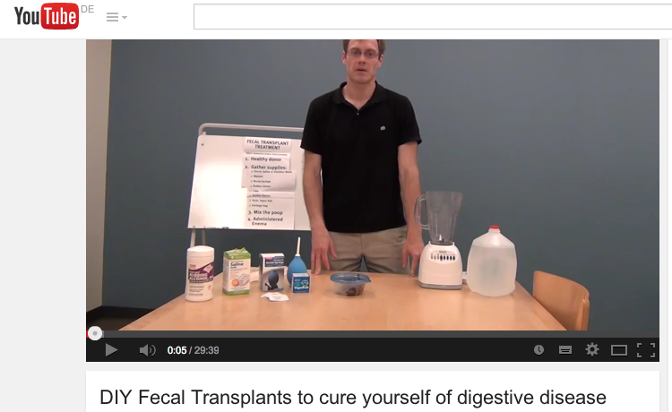
Urge to educate (with proper studies) public about therapeutic or non therapeutic effects of FMT
Notes:
DIY

Slide 19
Fecal transplant to study causality of fecal microbiota in human disease
PRO
CON
Small groupsizes sufficient to study causality
Every subjects is its own control (less variation)
Intervention allows taking intestinal biopsies next to fecal samples
No consensus for donor screening and fecal material treatment
Only one or two FMTs allowed
Variation of donor feces composition
Potential risk of transferring (multiresistant)bacteria/viruses/phages

Slide 20
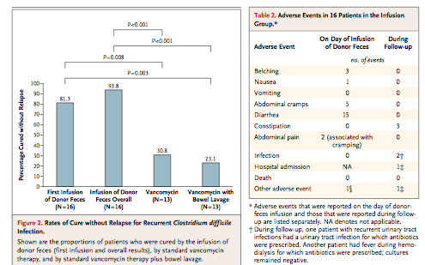
Effects of donor FMT in Clostridium difficile associated diarrhoea
81% succesrate after one FMT, 91% after twice FMT
Reproduced many times and FMT for rec C
Diff now in (European) Guidelines
Kelly ANN Int Medicine 2016
Lee JAMA 2016
Youngster/Homann, JAMA 2014
Several USA companies took up this concept
to bring FMT from lead to cure in C diff
Van Nood et al NEJM 2013

Slide 21
Relation microbiota and disease most likely not always causal
Causal
microbiota
Disease modifier
Level of complexity
Course of disease
Responders-non responders
Influence of genetics and diet
Multiple FMT or real failures
Concomitant medication
C difficile
post AB dysbiosis
IBD and IBS
Insulin resistance/TDM2
Autoimmune diseases (TDM1/ coeliakie)
Gut-brain axis diseases (autism)
Scheihauer/Nieuwdorp, Mol Metabolism 2016
Notes:
Trias van Koch voor vasculaire geneeskunde of marker wel echt marker C dif and post antibiotics; IBD IBS clinical trials; autism mouse studies

Slide 22
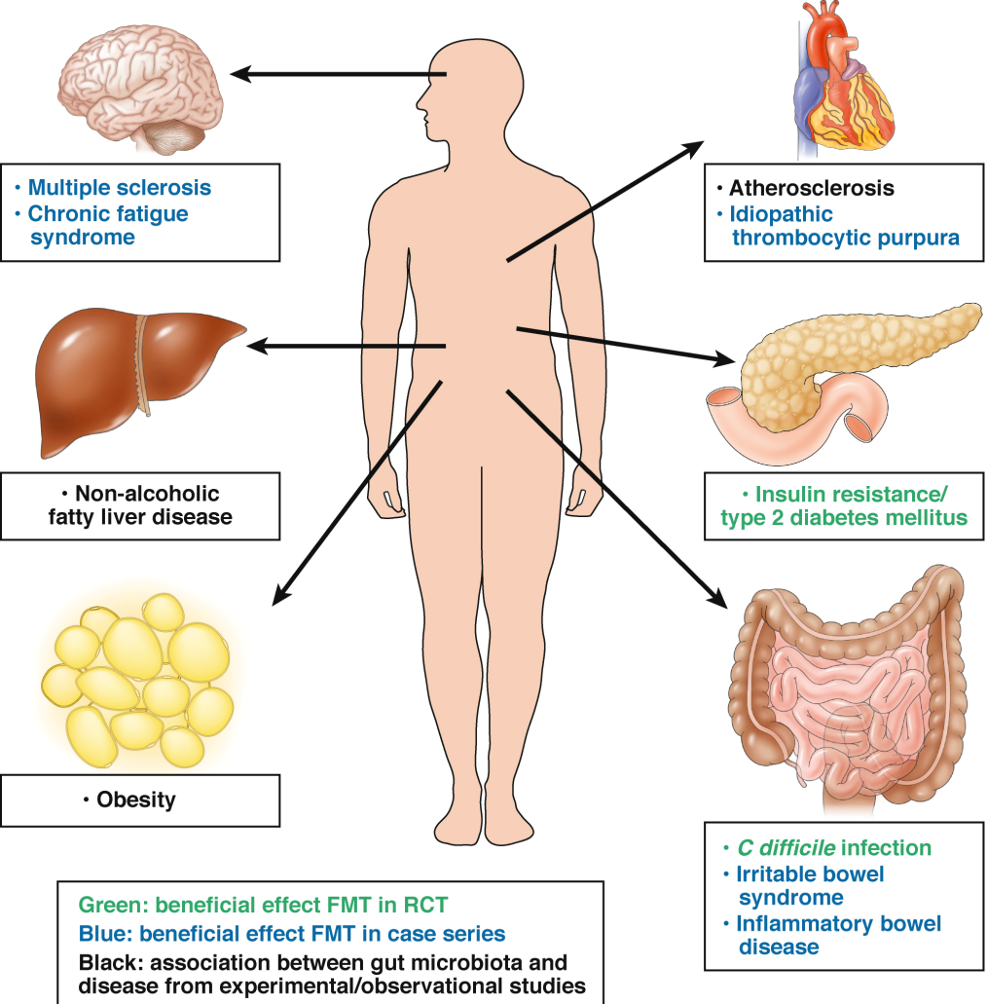
RCTof fecal microbial transplantation (FMT) in humans to improve cardiometabolic phenotype
at AMC >500 FMT’s since 2006, predominantly in RCT.
Long term side effects not observed
Adequate control difficult
At AMC ongoing/finished RCT’s with single/ multiple FMT using hard clinical endpoints for:
-atherosclerosis (TMAO)
- metsyn/type 2 diabetes
- NAFLD/NASH
- type 1 diabetes (T cel autoimmunity)
Smits/Nieuwdorp, Gastroenterology 2013 [; van Nood/Nieuwdorp, NEJM 2013 Rossen, Gastro 2015;Singh/Nieuwdorp, Clin Microbiol Infect. 2014 ; Rossen, Gastro 2015
Notes:
To own study scheme

Slide 23
Randomized controlled trial to study effect of allogenic lean donor versus own (autologous) FMT on insulin sensitivity
Lean to metsyn (Allogenic)
Own feces (Autologous)
Versus
De Groot/Backhed//Nieuwdorp, submitted
Notes:
Allogenic vs autologous

Slide 24
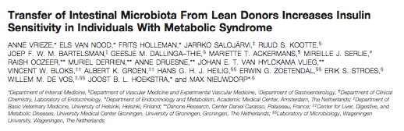
Fatloose1
RCT with 18 treatment naive male subjects with insulin resistance (metabolic syndrome).
1x Fecal transplant, No adverse effects!
23% improval of insulin sensitivity
No effect on weight, dietary intake and energy expenditure 6 weeks after lean donor FMT
A.Vrieze, Gastroenterology 2012
Notes:
23 seems marginal but

Slide 25
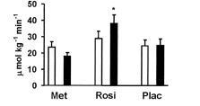
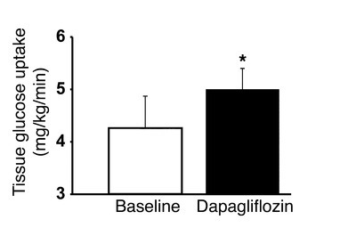
Effect of oral diabetes medication on peripheral insulin sensitivity (Rd)
Lean donor FMT:
insulin sensitivity (Rd)
increase 23%
PPARgamma agonist:
insulin sensitivity (Rd)
increase 18%
SGLT2 inhibition:
insulin sensitivity (Rd)
increase 22%
Vrieze, Gastroenterology 2012.
Karlsson, Diabetes. 2005;54(5):1459-67.
Merovci A, J Clin Invest. 2014;124(2):509-14

Slide 26
Randomized controlled trial to study effect of allogenic lean donor versus own (autologous) FMT on insulin sensitivity
Lean to metsyn (Allogenic)
Own feces (Autologous)
Versus
De Groot/Backhed//Nieuwdorp, submitted

Slide 27

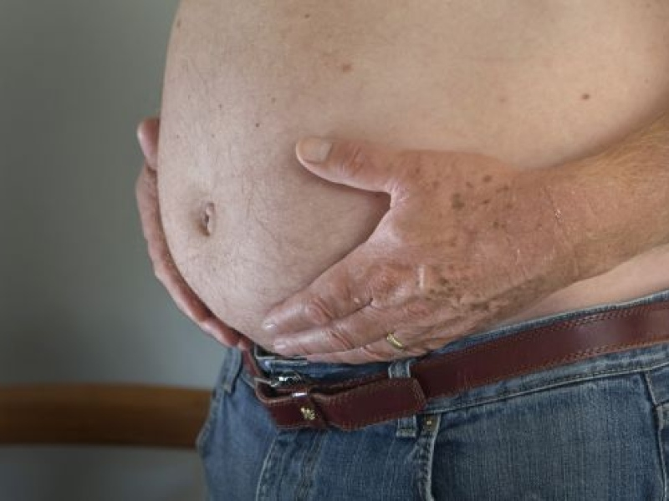
Study population
Fatloose2
Caucasian males, aged 49-60 with metabolic syndrome:
BMI 33-43 kg/m2,
fasting glucose >5.4 mmol/L
Waist circumference >102 cm
Diet monitoring
No medication!
Ruud Kootte
Kootte et al. Cell Metabolism 2017
Notes:
64 checked at 6 wks and 18 wks

Slide 28
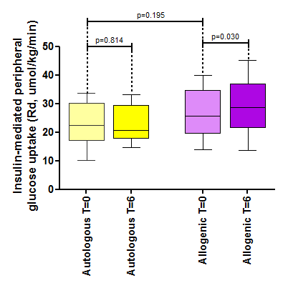
Effect donor FMT on peripheral insulin sensitivity
Kootte et al. Cell Metabolism 2017

Slide 29
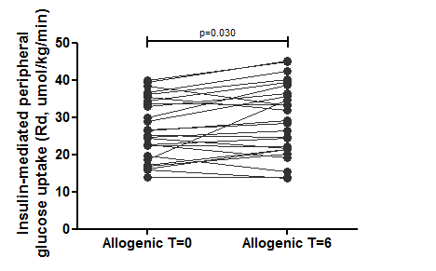
Individual data show considerable variation
Kootte et al. Cell Metabolism 2017
Notes:
Interesting effect; great variance two possibilities resp non resp or exp error

Slide 30
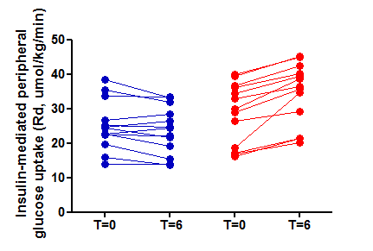
Responders and non-responders?
Kootte et al. Cell Metabolism 2017
Notes:
; great variance two possibilities resp non resp or exp error

Slide 31
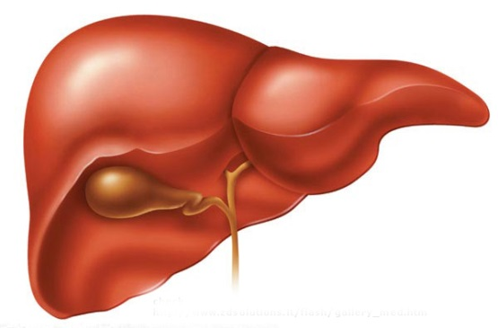
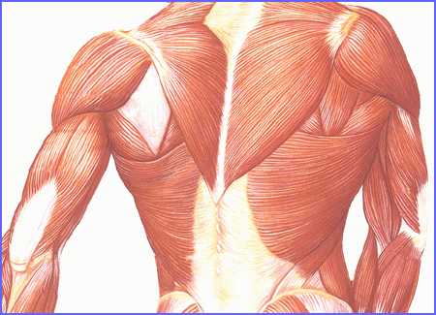
Hyperinsulinemic euglycemic clamp
Endogenous (hepatic) glucose production and (peripheral) glucose utilization
Overnight
fast
[6,6-²H₂]glucose bolus
Insulin prime
0 min
Steady state the last 20 min
2h
2h
2h
12h fast
Basal
Step 1 Clamp Step 2
Constant [6,6-2H2]glucose infusion (0.11 µmol · kg^{–1} · min^{–1} )
2h Constant insulin infusion (20 mU · m^{–2} · min^{–1)}
2h Constant insulin infusion (60 mU · m^{–2} · min^{–1)}
Variable 10% glucose infusion for plasma glucose 5 mmol/l
Notes:
Euglycemic hyperinsulinemic clamp; complex procedure but surprisngly variance less than 10%

Slide 32
Experimental error explains the difference?
Kootte et al. Cell Metabolism 2017
Notes:
How to investigate?

Slide 33
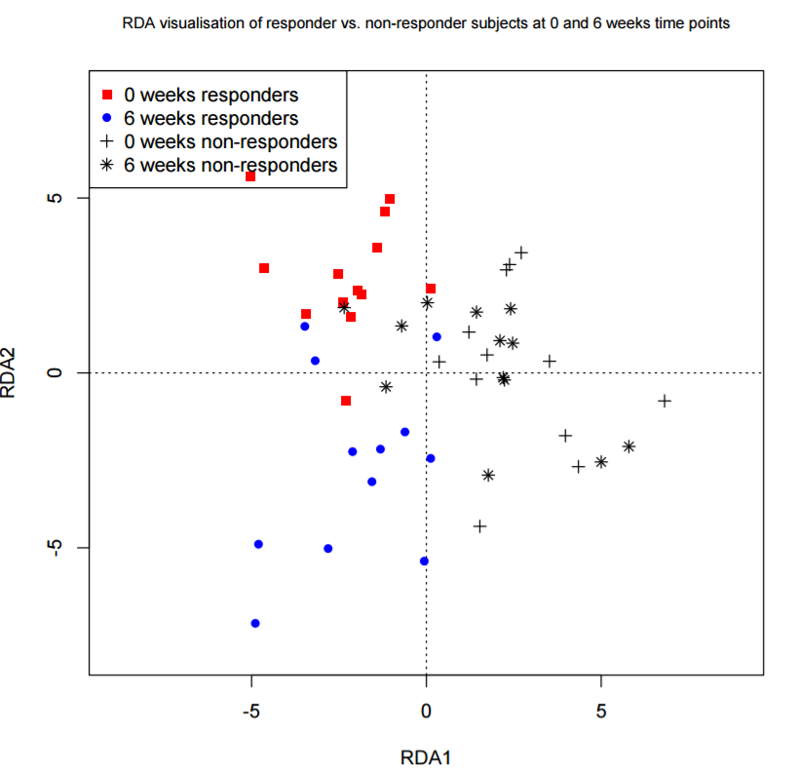

Responders and non-responders can be discriminated by baseline gut microbiota
Kootte et al. Cell Metabolism 2017
Notes:
microbiota comp is different after 6 wks in resp compared to non resp

Slide 34
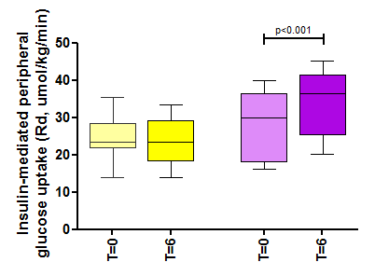
Non-responders
Responders

Slide 35
Baseline (lower) microbial diversity predicts better clinical response upon donor FMT (posthoc analyses)
Kootte/Nieuwdorp, Cell Metabolism 2017
Notes:
Diversity at baseline is different compoistion as well; panel has been generated that prdicts response

Slide 36
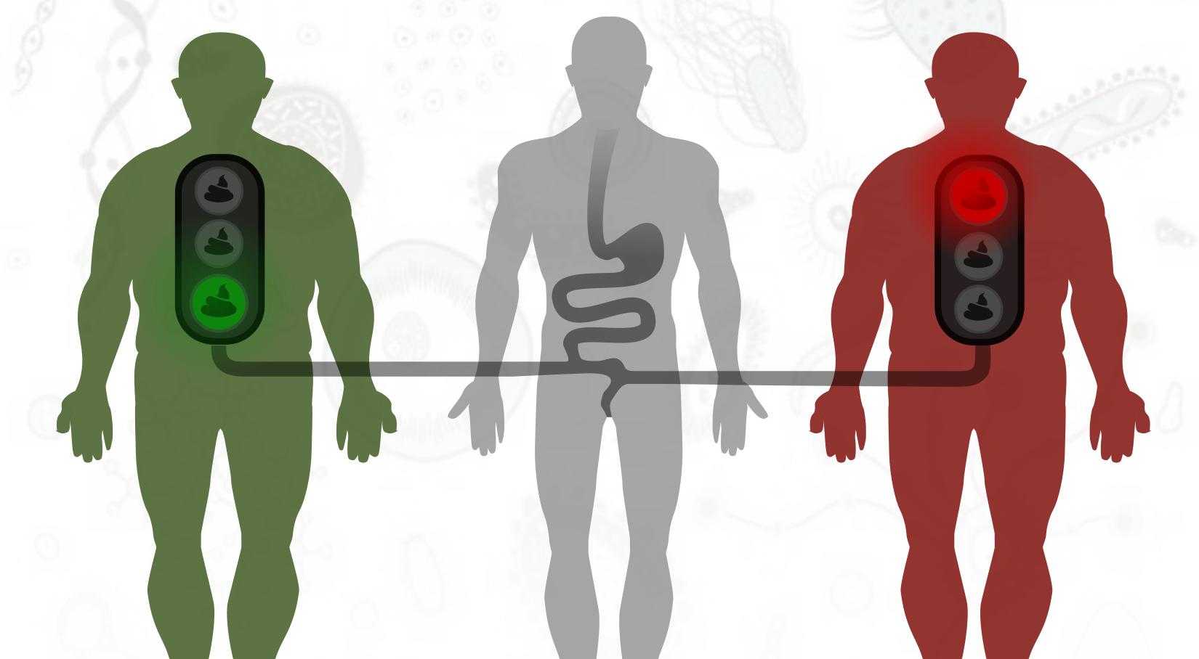
Responders and non responders due to donor or recipient FMT characteristics?
Kootte/Nieuwdorp, Cell Metabolism 2017

Slide 37
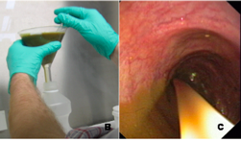
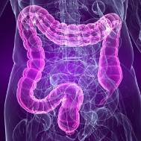
Engraftment of donor strains after FMT can be studied
By studying bacterial SNPs
Engraftment
Intermediate
No engraftment
Li/Nieuwdorp/deVos/Bork, Science 2016

Slide 38
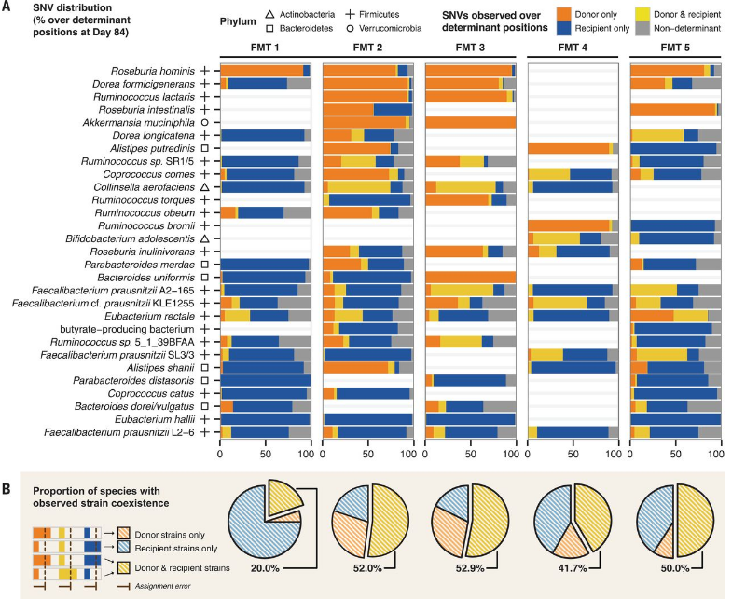
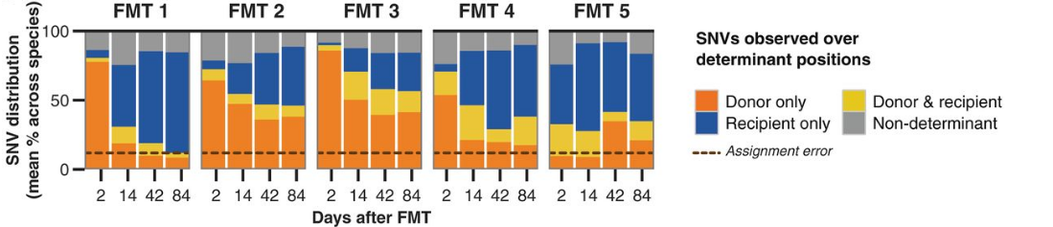
Donor FMT Engraftment of new microbiota varies greatly between metsyn subjects
Same lean donor
Li/Nieuwdorp/de Vos/Bork, Science 2016
Notes:
Effect of 5FMT’s with same donor, donor iin orange recipient in blueSome people do accept donor FMT, some don’t.
PMID 27126044

Slide 39
Differential effect on 1 donor in several metsyn subjects on peripheral insulin sensitivity
No superdonor effect but super acceptor (engraftment)
Kootte/Nieuwdorp, Cell Metabolism 2017

Slide 40
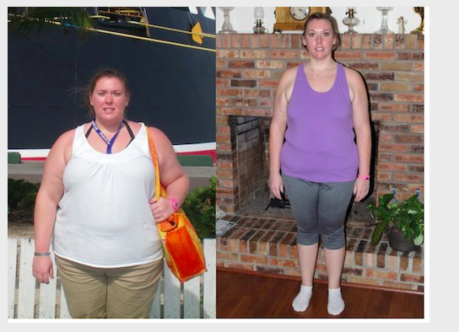
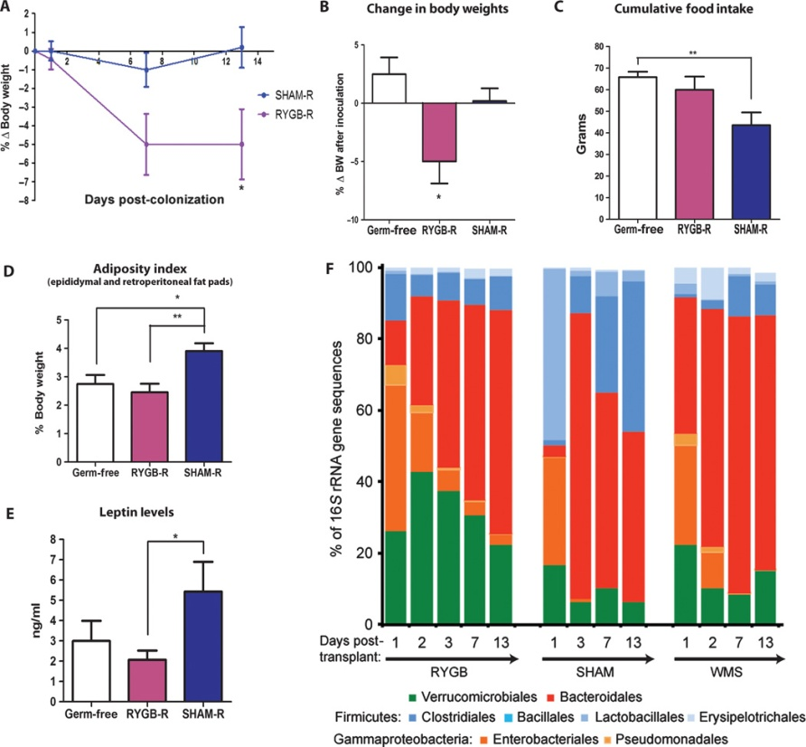
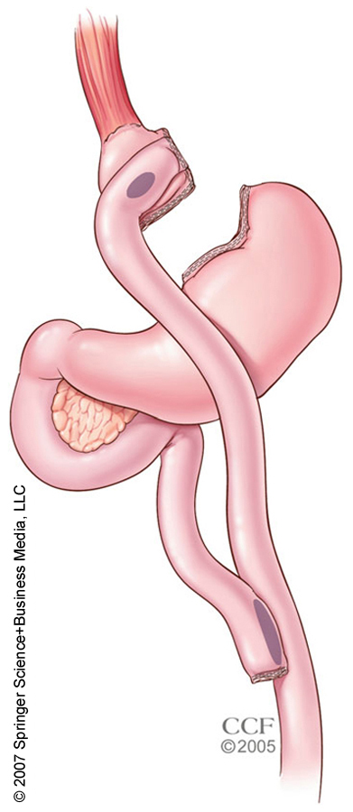
How about using donor feces from (previous) metabolically compromised subjects?
Roux-en-Y Gastric Bypass
40kg weightloss in
3 years
Liou, Sci Transl Med. 2013 Mar 27;5(178):17
Microbiota composition after bariatric surgery cause or consequence?
Notes:
Well known effect of bariatic surgery induces large changes. Does microbiota pla a role in effect, if so FMT should induce weight loss. Here dat of mouse exp

Slide 41
Randomized controlled trial to study effect of postbariatric surgery FMT versus Metsyn FMT on insulin resistance
Postbariatric surgery to metsyn (RYGB-Recipient)
Metsyn to metsyn (Mets-Recipient)
Versus
De Groot/Backhed//Nieuwdorp, submitted

Slide 42
Effect of post bariatric surgery feces vs allogenic metsyn on insulin sensitivity of metsyn
No overall effect on insulin sensitivity
and weight, but some responders!
Allogenic metsyn-metsyn induced
More insulin resistant in all subjects!
De Groot, et al.
Notes:
No effect or maybe in some, but mets to mets detoriation

Slide 43
3. Is the therapeutic effect of FMT driven by changes in plasma metabolites on periperal organs?
Holmes E, Cell Metabolism 2012 16, 559-564
Notes:
How does it work, change in metabolites effects muscle metabolism or effect on gut brain axis. Which metabolites are affected?

Slide 44


Lean donor FMT affects fasting plasma metabolites profile
Cervenka, Science 2017
autologous FMT allogenic FMT
LEAN FMT increases plasma metabolites involved in signalling (serotonin/dopamine)
OWN FMT increases oxidative stress related metabolites
Kootte/Nieuwdorp, Cell Metabolism 2017

Slide 45
Role of gutmicrobiota on host dopamine and serotonin metabolism
Serotonin/dopamine production (involved in central regulation of metabolism and colonic
transit time) is mediated by gutmicrobiota composition (butyrate producers) in animals
Cervenka, Science 2017; Battaray, Am J Physiol 2017
Notes:
Signal transduction in gut? Or brain

Slide 46
Does FMT from postbariatric surgery donors affect serotonin and dopamine brain receptor expression in human metabolic syndrome? And is oral butyrate a beneficial treatment?

Slide 47
Does donor FMT affect brain serotonin-dopamine metabolism in humans?
Relation with butyrate or butyrate-producing bacteria?
N=12 male-female metabolic syndrome
Placebo tablets 4 wks
Post-bariatric surgery donor FMT (butyrate- producing bacteria)
N=12 male/female metabolic syndrome
Butyrate tablets 4 wks
Placebo (autologous) FMT
vs
Notes:
The question is whether butyrate itself or the butyrate-producing bacteria have this benificial effect on human metabolism.
Why donorfeces of post-RYBG: a more pronounced increase in scfa producing strains compared to lean donors

Slide 48
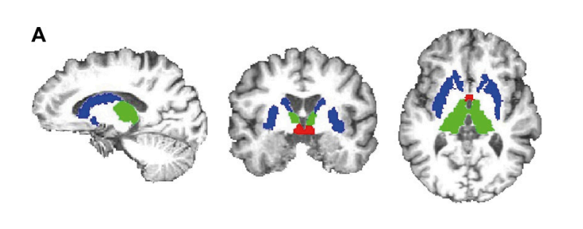
Brain SPECT + MRI scan
Intravenous Radiotracer labeled 100 MBq ¹²³I-FP-CIT binds:
Serotonin receptor expression in thalamus and hypothalamus (2h after infusion)
Dopamin receptor expression in striatum (visualized 3h after infusion radiotracer)
Notes:
Before and after 4 weeks subjects underwent single photon emission computed tomography (SPECT) 2 and 3 h after intravenous administration of a radiotracer.This radiotracer binds predominantly to DAT in the striatum and to SERT in extrastriatal brain areas. Extrastriatal SERT and striatal DAT binding can be assessed optimally at 2 and 3 h after bolus injection, respectively, as previously described (33)

Slide 49
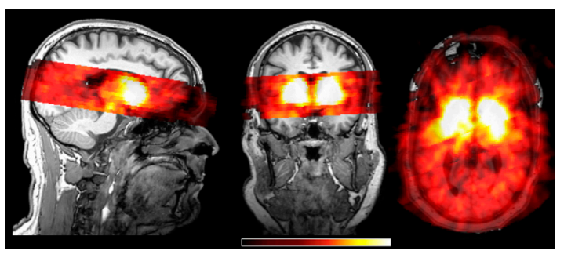
Brain SPECT coregistered to individual MRI (ROI analysis)
ROI striatum for Dopamine receptor binding (DAT)
ROI thalamus and hypothalamus for Serotonin receptor binding (SERT)
Notes:
Then we performed a region of interest or ROI analysis. By overlaying the spectscan with masks of the regions of interest which are the striatum for DAT and thalamus and hypothalamus for SERT.

Slide 50
ROI analysis Bindingpotential (BP) per region of interest
striatum
thalamus
hypothalamus
Notes:
This allows us to calculate the binding potential of the radiotracer in the regions of interest, which are the striatum for DAT and thalamus an hypothalamus for SERT.
The cerebellum was used as a reference region for nondisplaceable binding (nonspecific binding and free radioactivity). Specific to nonspecific binding ratios were calculated as follows: (mean ROI binding -mean nonspecific binding assessed in the cerebellum)/mean nonspecific binding cerebellum, which represents the binding potential (SNS-BR).

Slide 51
Donor FMT increases dopamine receptor expression
Change over time (0-4 weeks) between two treatment groups
Donor FMT effect (no weightloss)
(p<0.05)
Hartstra/Sanz/Nieuwdorp, unpublished data
Versteeg/Serlie, FASEB 2017
Notes:
But when you look at the change over time between both groups the change is significant: so striatal binding ratios increased in the Ftx group and decreased in the butyrate group, resulting in a significant change over time between both groups.

Slide 52
Donor FMT increases dopamine receptor expression
Change over time (0-4 weeks) between two treatment groups
Donor FMT effect (no weightloss)
For comparison:
7kg weightloss upon diet has similar effect
(p<0.05)
Hartstra/Sanz/Nieuwdorp, unpublished data
Versteeg/Serlie, FASEB 2017
Notes:
But when you look at the change over time between both groups the change is significant: so striatal binding ratios increased in the Ftx group and decreased in the butyrate group, resulting in a significant change over time between both groups.

Slide 53
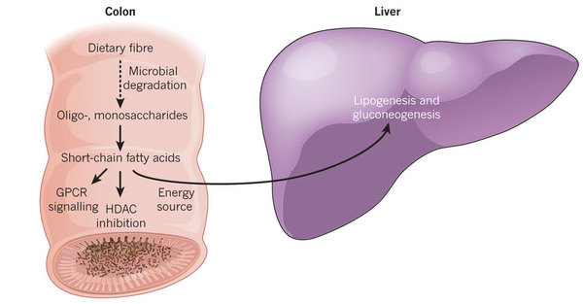
Short chain fatty acids (ScFA) are best studied microbial metabolites in relation to metabolism
SCFA-acetate (50%) 2
-butyrate (30%) 1
-propionate (20%): 1
CONSENSUS: Low butyrate producers&levels in metsyn/DM2
Backhed, Nature 2012,Vrieze 2014
Notes:
Complex carbohydrates (dietary fibre) are metabolized by the colonic microbiota to oligosaccharides and monosaccharides and then fermented to short-chain fatty acid end-products, mainly acetate, propionate and butyrate. SCFA are absorbed in the colon where butyrate provides energy for colnic epithelial cells and via portal vein system has direct effects on hepatic lipogensis. Acetate and propionate reach the liver and peripheral organs via small intestine, where they are substrates for gluconeogeneis.

Slide 54
Does supplementation of butyrate improves glucosemetabolism in lean and metsyn subjects?
Sodium butyrate orally (4 gram/day)
Studyday 1:
clamp [6,6-2H2]glucose
Feces
Dietlist
Compliance
Studyday 2:
clamp [6,6-2H2]glucose
Feces
Dietlist
Compliance
4 weeks
Baseline

Slide 55
Effect oral butyrate on peripheral and hepatic insulin sensitivity in lean and metsyn
15% increase in peripheral insulin sentivity
Only in leans
10% increase in hepatic insulin sensitivity
Only in leans
Bouter/Backhed/Nieuwdorp, Clin Translational Gastroenterology 2018

Slide 56
Correlations between clinical markers and and SCFAs in feces and plasma 4 weeks of butyrate significantly different in leans vs metsyn
Lean
Metsyn
Lean
Metsyn
Oral treatment with butyrate associated with
improved insulin sensitivity (Rd) in lean subjects
Oral treatment with butyrate associated with increased
plasma LDL cholesterol in metabolic syndrome subjects
Bouter/Backhed/Nieuwdorp, Clin Translational Gastroenterology 2018
Notes:
(red = negative, blue = positive correlation)

Slide 57
4. Replenishing missing intestinal metabolites and (single strain) microbiota on human (glucose) metabolism and obesity is still a black box!
Holmes E, Cell Metabolism 2012 16, 559-564

Slide 58
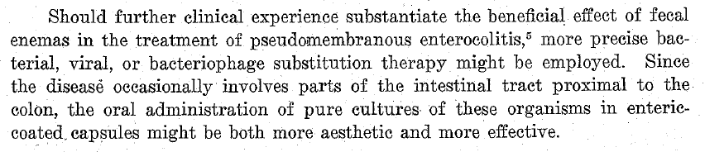
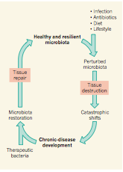
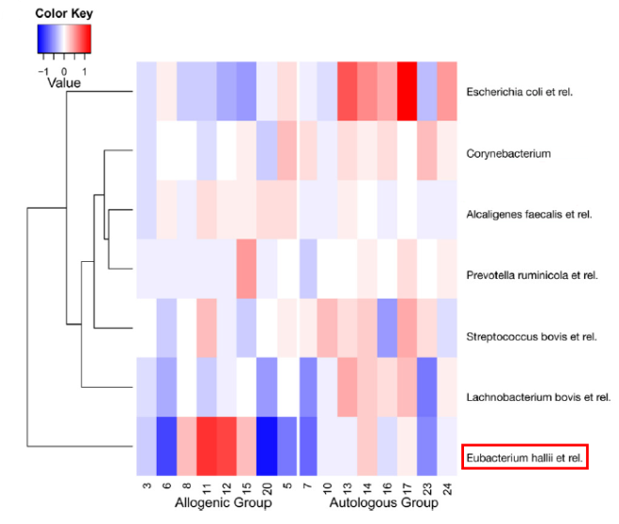
FMT allows to mine for beneficial and adverse intestinal bacteria in diabetes/insulin resistance
Eiseman (Surgery 1958)
Reverse engineering to achieve (personalized)
optimal gutmicrobiota composition
Vrieze et al , Gastroenterology 2012; Nieuwdorp et al, Nature 2013

Slide 59
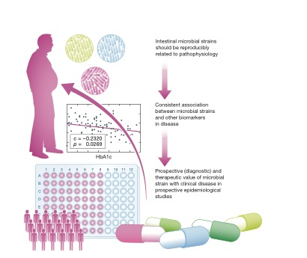
Replenishing (missing) intestinal microbiota or metabolites might improve metabolism in human obesity
Pitfalls and hurdles
GMP production bacteria as novel probiotics (culture medium and > 80 liter of production) like E hallii and Akkermansia
Single vs multiple strains (GMP) and located delivery (small-large intestine)
Large and expensive phase I-IV clinical trials for validity (mouse ≠ men)
No one size fits all …(personalized medicine due to responders-non responders)
Nieuwdorp &Groen, Embo 2016

Slide 60
Take home message
Gutmicrobiota composition is driven by several factors including ethnicity
Intestinal microbiota may indeed play a small causal role in human metabolic disease
Donor bacterial ENGRAFTMENT (responders) differs between human subjects and may be predicted on baseline fecal sample microbiota composition
Gutmicrobiota seem to affect the gut brain axis
Reconstitution of single/multiple beneficial bacterial strain(s) in combination with diet to increase engraftment is still far from becoming a blockbuster treatment for insulin resistance and DM2

Slide 61






Acknowledgements
AMC VUMC diabetesgroup
Max Nieuwdorp
AMC
Kristien Fluitman MD (Vumc)
Michiel van Baar MD (Vumc)
Lotje van Ruiten MD (VumC)
Erik van Bommel, MD (Vumc)
Technicians
Maaike Winkelmeijer, Bsc
Jorn Hartman Bsc
Alinda Schimmel Bsc
Postdocs/Staff
Geesje Dallinga PhD
Hilde Herrema, PhD
Daniel van Raalte, MD PhD
Melanie Deschaschaux PhD
Han Levels PhD
Onno Holleboom MD PhD
Bioinformaticians
Evegeni Levin, PhD
Andrei Prodan, PhD
Sultan Imangaliyev, PhD
Mark Davids PhD
PhD students
Pim Gilijamse, MD
Kasper ter Horst, MD Loek Smits, MD
Kristien Bouter, MD
Pieter de Groot, MD
Annick Hartstra MD
Guido Bakker, MD
Stijn Meijnikman, MD
Annieke van Baar, MD
Omrun Ayden MD
Ilias Attaye MD
Casper van Olden, MD
Nicolien de Clercq, MD
Torsten Scheithauer, Msc
Madelief Wijdeveld MD
Jayron Habibe Msc
Annefleur Koopen, MD
Julia Witjes MD
Bart Roep
LUMC/
City of Hope
Willem de Vos
WUR
Peer Bork
EMBL,
Heidelberg
Fredrik Backhed,
Gothenburg

